Slide 1


ProPublica recidivism Use Case
(Compas risk assessment tool)
Transparency & Fairness in AI and Big Data Algorithms
LYOUSFI Youssef
Dimitris KOTZINOS
Vassilis CHRISTOPHIDES
M2 Data Science & Machine Learning
03/03/2023

Slide 2
Overview
Compas algorithm
Bias Detection & Mitigation
Reweighing preprocessing
Optimized preprocessing
Adversarial Inprocessing
Calibrated Odds PostProcessing

Slide 3
Compas
Correctional Offender Management Profiling for
Alternative Sanctions
Recidivist
Yes
Output
Compas
Algorithms
Risk
Factor
No
Not Recidivist
High risk factor ?
The higher the risk factor, the more you become a recidivist
Notes:
In the criminal justice system, predictive algorithms have been used to predict who is most likely to commit a violent crime, who is likely to reoffend at some point in the future
Compas predicts a defendant’s risk of committing a misdemeanor or felony within 2 years of assessment from 137 features about an individual and the individual’s past criminal record
The Risk Factor quantifies the likelihood the defendant will commit another crime in the future (recidivist)
Problem: They have found that COMPAS is disadvantageous to black defendant (Either guilty or not), Although the data used by COMPAS do not include an individual’s race

Slide 4
(predicted to reoffend, but don’t)
False Positive
Black: 44.9%
White: 23.5%
(predicted not to reoffend, but did)
False Negative
Black: 28.1%
White: 47.7%
If you are black, you are more likely to be assessed as high risk than if you were white
The accuracy, fairness, and limits of predicting recidivism | Science Advances
Notes:
Compas affected black and white defendants differently: Black defendants who did not recidivate were incorrectly predicted to reoffend at a rate of 44.9%, nearly twice as high as their white counterparts at 23.5%;
and white defendants who did recidivate were incorrectly predicted to not reoffend at a rate of 47.7%, nearly twice as high as their black counterparts at 28.0%.
COMPAS scores appeared to favor white defendants over black defendants by underpredicting recidivism for white and overpredicting recidivism for black defendants.

Slide 5
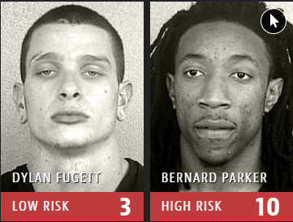
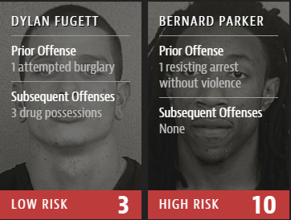
Fugett was rated low risk after being arrested with cocaine and marijuana. He was arrested three times on drug charges after that
Machine Bias — ProPublica
Notes:
As you can see, Dylan was rated low risk although he has 1 attempt of burglarisation and 3 drugs possessions, while Parker was rated high risk of 10 and as you can see, he is none subsequent offences. So race attributes is

Slide 6
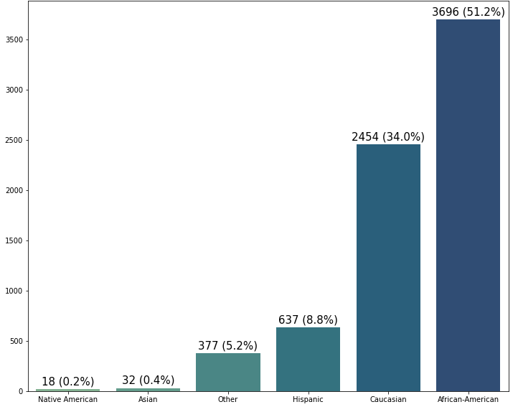
Race attribute distribution

Slide 7
White
(Privileged Group)
Race attribute distribution
Notes:
Our aim is to reduce the bias for the African- American race, by applying different mitigation techniques
To do so, we have to introduce some mitigation, either before, during or after training our machine learning algorithms, because ML algorithms alone are trained to be more accurate and not fair.

Slide 8
Bias Detection & Mitigation
Notes:
We will talk about fairness metrics before moving to the algorithms

Slide 9
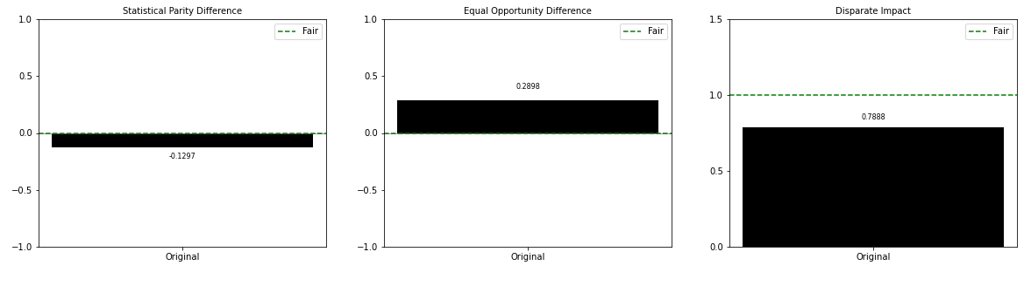
Fairness Metrics on Original Dataset
Bias Detection & Mitigation
Notes:
Statistical parity: it means that the proportion of positive outcomes should be the same for all groups, regardless of their race, gender, or other protected characteristic.
Equal opportunity difference — This is the difference in true positive rates between unprivileged and privileged groups. A value of 0 implies both groups have equal benefit.
Disparate Impact — This is the ratio of probability of favorable outcomes between the unprivileged and privileged groups.

Slide 10
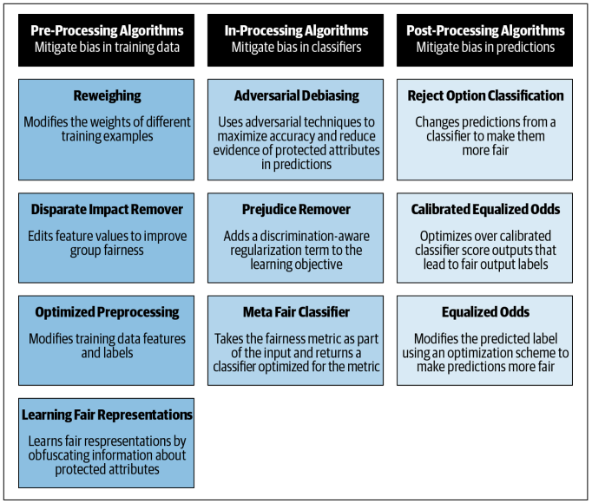
Bias Mitigation Algorithms
Bias Detection & Mitigation

Slide 11
The Algorithms used
Bias Detection & Mitigation

Slide 12
Reweighing Preprocessing
Notes:
reweighing assigns weights to instances of the training data while leaving the data itself unchanged

Slide 13
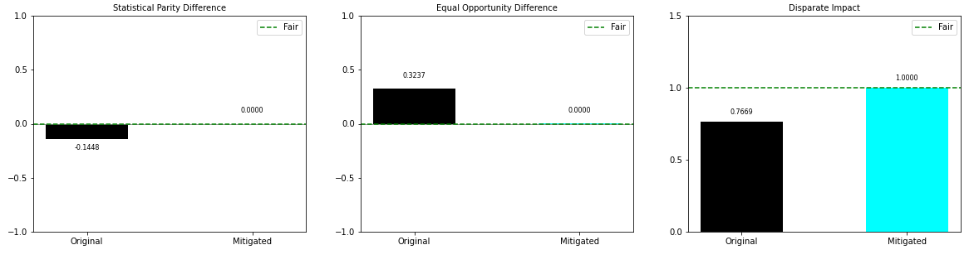
Fairness Metrics after Reweighing technique
Reweighing processing

Slide 14
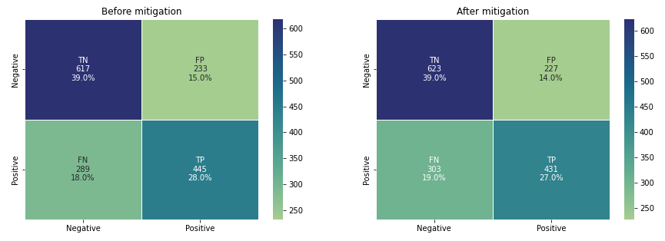
Confusion Matrix for Random Forest
Reweighing processing
Notes:
FPR indicates the incorrect classification. These were the offenders belonging to the African-American race who were incorrectly labeled as Higher risk group. After mitigating the bias, we see that the False positive rate has decreased
The false positive rate is the fraction of non-recidivists who were classified as high risk
The false negative rate is the fraction of recidivists who were classified as low risk.

Slide 15
Optimized Preprocessing
Notes:
learns a probabilistic transformation that edits the features and labels in the data with group fairness, individual distortion, and data fidelity constraints & objectives

Slide 16
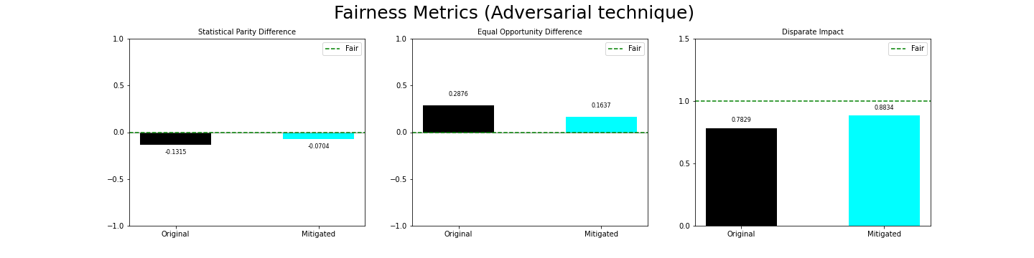
Fairness Metrics after Optimized technique
Optimized processing
16

Slide 17
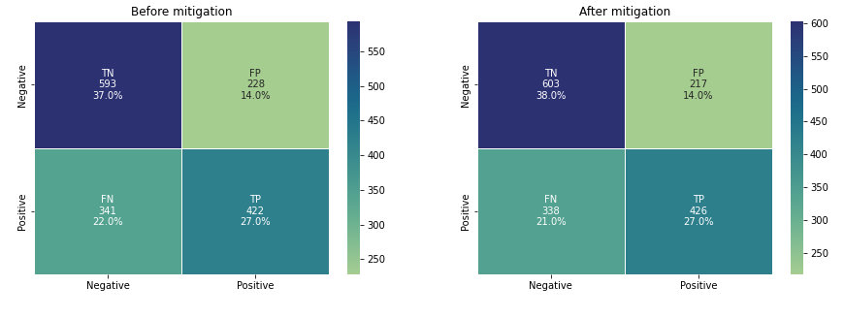
Confusion Matrix for Random Forest
Optimized processing

Slide 18
Adversarial Inprocessing
Notes:
Which aims to reduce the impact of protected attribute in predictions

Slide 19
Fairness Metrics after Adversarial technique
Adversarial processing

Slide 20
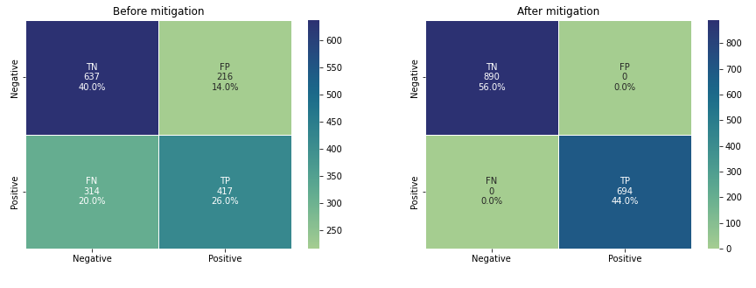
Confusion Matrix for Random Forest
Adversarial processing

Slide 21
Calibrated Odds post-processing
Notes:
Which aims to reduce the impact of protected attribute in predictions

Slide 22
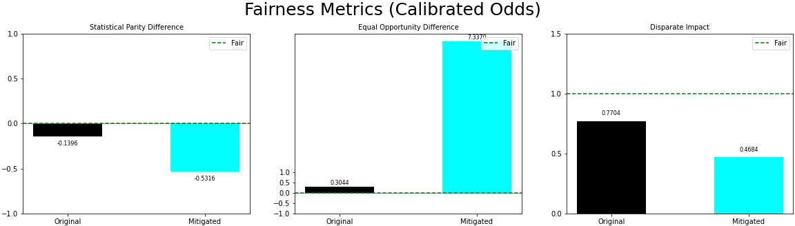
Fairness Metrics after Calibrated Odds technique
Calibrated Odds processing

Slide 23
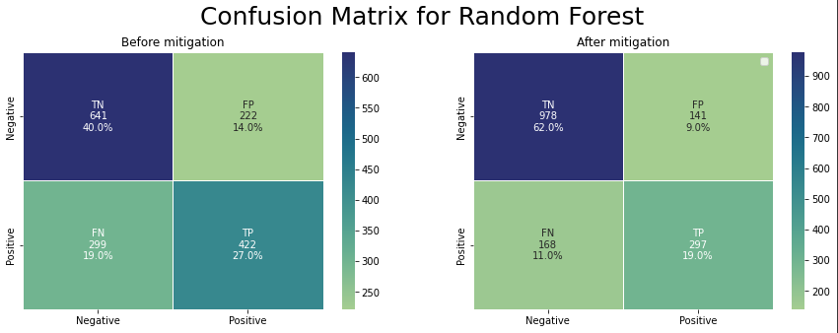
Confusion Matrix for Random Forest
Calibrated Odds processing

